Slide 1
Research work on Food system
Esther Tatenda Chawanda
Phd Application: Ecofoodsytems Project

Slide 2
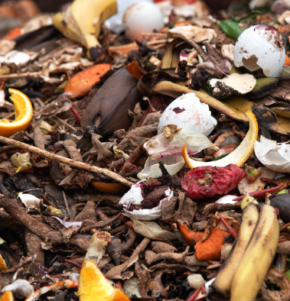
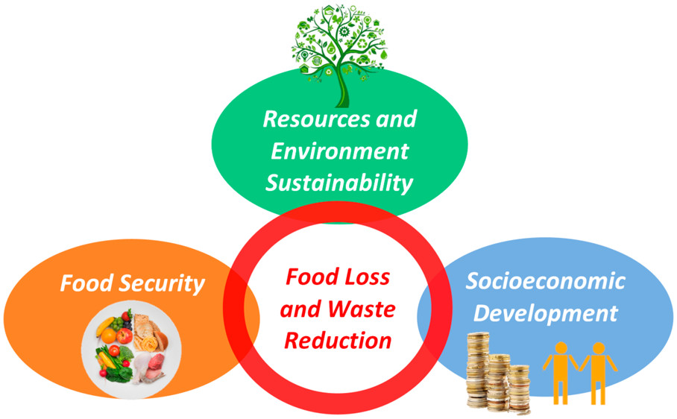
Green city initiatives and market management: Rikolto international, Belgium
Aim:
Contributes towards the development of strategic framework for FAO’s Green Cities initiatives in Africa
Investigate the impact of food market management modalities and areas to improve
- social inclusion
- Environmental sustainability & food waste reduction
Methodology:
1. Literature review :
climate – resilient practices and technologies
Circular and inclusive urban and peri-urban developments
2. Workshop consultant: Kenya and Ghana
cities’ challenges, project implementation,
types of assistance from FAO and Rikolto
3. Interviews with Rikolto East Africa Global Team

Slide 3
Cont’
Activities:
Drafted an overview of key food system challenges, food flow and food markets related to the food system of targeted cities.
Mapped key stakeholders, existing food systems initiatives and their progress.
Advising on future Green Cities Initiatives in African cities.
Designed a multisectoral food environment intervention for use in low- and middle-income settings.
Findings:
Food waste in developing countries is mainly driven by postharvest losses as a result of a lack of technology and restricted market access.
Farmers still have no access to direct food markets:
Women are still not empowered: no access to land and bank loans:

Slide 4
Cont’
Conclusion:
To preserve fresh produce from the farmers and to create a more hygienic environment, it is necessary to invest in suitable storage facilities and improve traditional markets.
There is a needs to connective infrastructure, urban planning, economic incentives, capacity support and mandatory regulations.
More support is needed to empower women to access green technologies, services and information and to participate in decision making related to food waste.
Achievements/outcomes
Obtained knowledge in writing food system policy briefs.
Gained expertise in designing interventions for the food system
In overall, compiled investigations will be used by FAO and Rikolto as an entry point to improve food systems in African countries through the introduction of green cities initiatives and good market management that is tailor made for the farmers, vendors and consumers behaviour.

